Slide 1
File handling
Object Oriented Programming

Slide 2
Introduction
File handling in C++ involves working with files to perform operations such as reading, writing, and manipulating data.
C++ provides classes and functions in the <fstream> library for file handling operations.

Slide 3
File Modes in C++
C++ supports different file modes that define how a file can be opened and accessed:
ios::in: Open file for reading.
ios::out: Open file for writing.
ios::app: Append to a file (write at the end).
ios::trunc (Truncate Mode):It truncates (clears) the contents of the file if it already exists.

Slide 4
File Operations in C++
Opening a File: Use fstream objects like ifstream for reading and ofstream for writing. Example: ifstream inFile("filename.txt");
Reading from a File: Use >> or getline() to read data from a file into variables or strings.
Writing to a File: Use << to write data to a file. Example: ofstream outFile("output.txt"); outFile << "Hello, File Handling!";
Closing a File: Use close() method to close the file after operations.

Slide 5
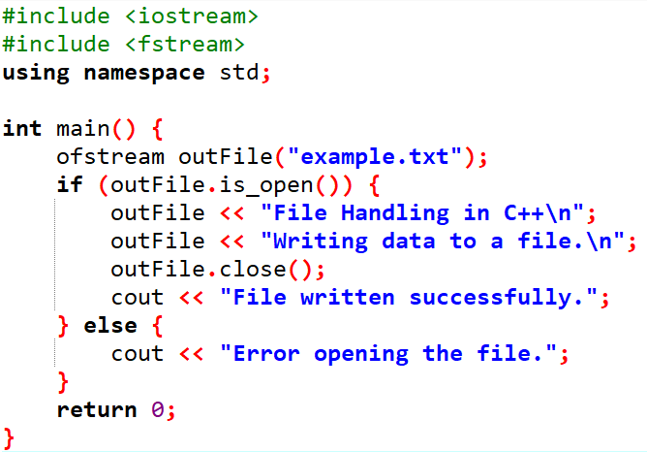
Example for write In file

Slide 6
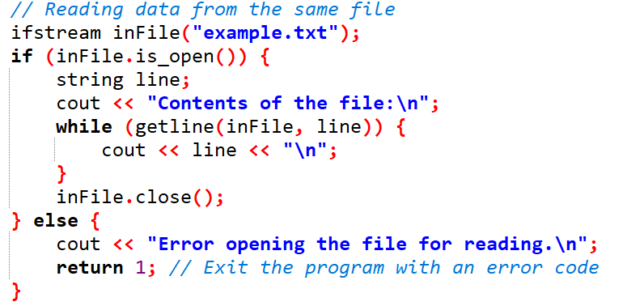
Example for read In file

Slide 7
Best Practices for File Handling in C++
Check if the file opened successfully before performing operations.
Handle file exceptions and errors using try-catch blocks.
Close files after use to release system resources.
Use file modes appropriately based on the intended file operation.
Avoid hardcoding file paths for portability and flexibility.

Slide 8
ANY questions!!!
Thank You….

